Slide 1
INFERENTIAL STATISTICS
Sriram

Slide 2
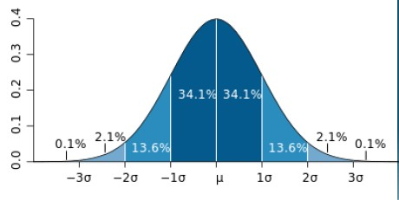

Normal Distribution

Slide 3
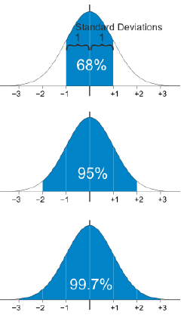

Normal Distribution

Slide 4
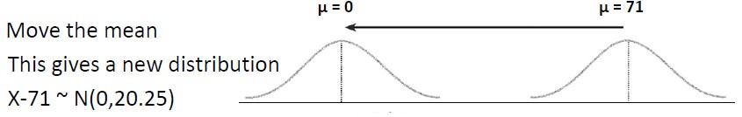
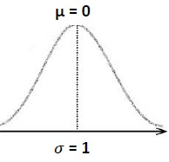
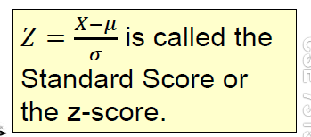
Standard Normal Distribution

Slide 5


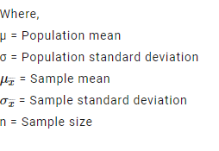
Central Limit Theorem
The Central Limit Theorem is the sampling distribution of the sampling means approaches a normal distribution as the sample size gets larger, no matter what the shape of the data distribution
Key Points
Mean of sample is same as mean of the population.
Standard deviation of the sample is equal to standard deviation of the population divided by square root of sample size.

Slide 6
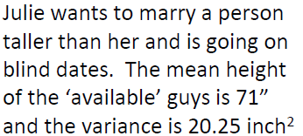
Calculating Probability using Z table

Slide 7

Calculating probability using Z table

Slide 8
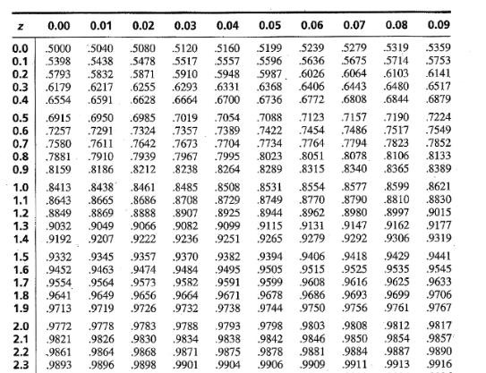
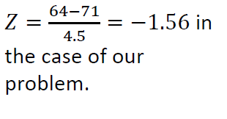
Solution

Slide 9
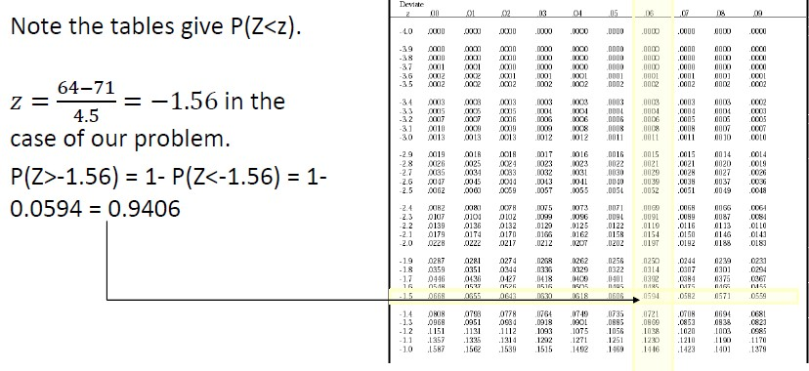
Note:
Z table gives probability less than Z value and to find the probability more than the Z value, subtract 1 from the probability found in the Z table.

Slide 10
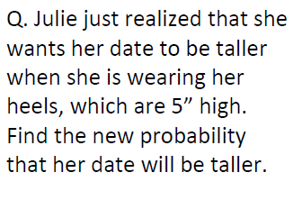
Continuation..
Will this impact on the existing probability ?

Slide 11
New Probability

Slide 12
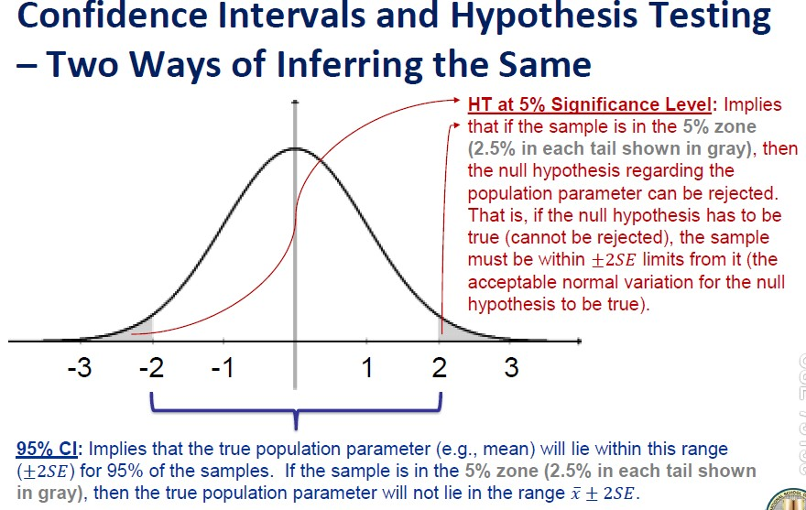

Slide 13
Critical Region & Significance level
Critical region:
The region in the tail of the distribution which corresponds to the rejection of the null hypothesis at some chosen significance level.
Z Critical Value:
The Z value which separates the critical region from the rest of the region in the distribution. Any Z value higher than Z critical value means that the value is in the critical region.
Significance Level:
The probability level of that is chosen to test the hypothesis testing in statistics. They are 3 levels - 10%, 5%, 1% and normally if this is not provided during testing then 5% is what chosen as a standard.

Slide 14
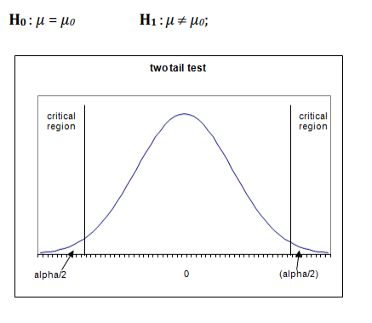
One tailed & two tailed test
The statistical tests used will be one tailed or two tailed depending on
the nature of the null hypothesis and the alternative hypothesis
1. Two Tail test

Slide 15
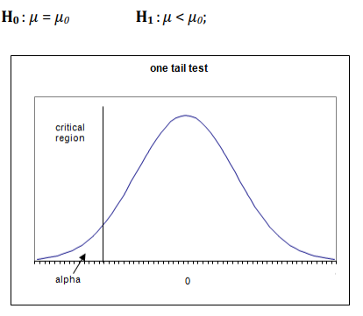
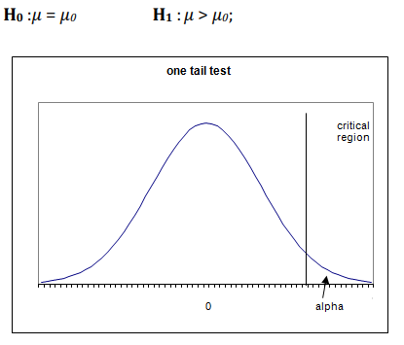
2. One Tail tests

Slide 16

One tail test – Z critical values
α (Significance level) = 10 %
Z = 1.28
α (Significance level) = 5 %
Z = 1.64
3. α (Significance level) = 1 %
Z = 2.29
Sample of 1 tail test

Slide 17
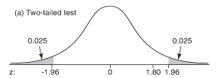
Two Tail Test
α level
Z critical values
0.10 | 1.645
0.05 | 1.960
0.010 | 2.576
Sample of 2 tail test

Slide 18
Hypothesis Testing
Hypothesis testing is the explanation of the phenomenon -
scientific proof of concept about the event
Null Hypothesis (H₀)
Alternate Hypothesis (H_{a})

Slide 19
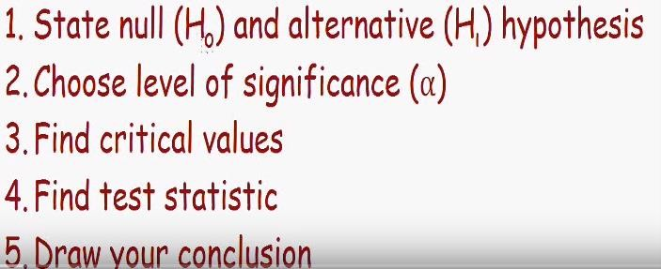
Hypothesis Testing Steps

Slide 20
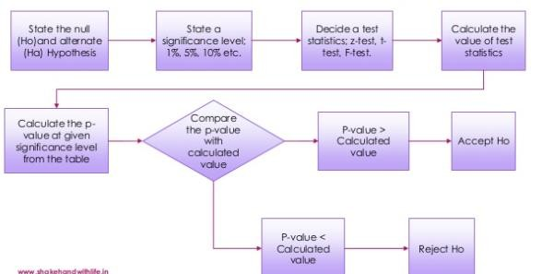
Steps - Flowchart

Slide 21
Identify Null & Alternate Hypothesis
It is believed that a candy machine makes chocolate bars that are 5g on average. A worker claims that after maintenance it no longer makes 5g bar.
Write Null and alternate hypothesis ?
NOTE:
Both are mathematical opposites

Slide 22
Identify Null & Alternate Hypothesis
It is believed that a candy machine makes chocolate bars that are 5g on average. A worker claims that after maintenance it no longer makes 5g bar.
Write Null and alternate hypothesis ?
H₀ = 5
H_{a} ≠ 5
NOTE:
Both are mathematical opposites

Slide 23

Hypothesis Errors

Slide 24

Type 1 & Type 2 Errors

Slide 25
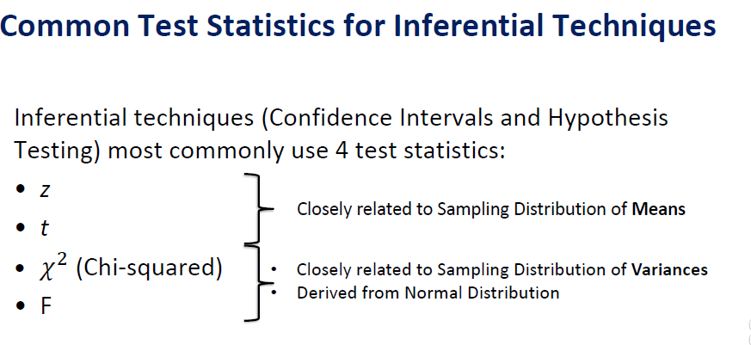

Slide 26
Z Test
In a survey conducted for the psychological test about the students attitudes towards studying with the range of score between 0-200. The mean score is 115 and SD is 30. John suspects that older students have better attitudes and selects 35 students more than 30 years to test and the mean score is 118.6
Carry out the significance test at 0.05 ?

Slide 27
Solution
State hypothesis
H₀ = 115
H_{a} > μ (115)
Significance level α = 0.05
Z critical value Z = 1.64
Given parameters
μ = 115, σ = 30, n= 35, sample mean = 118.6
Find Z ?

Slide 28

Z - Test Statistic
Substituting the parameters
Z=0.74
Using Z table – find probability
P(Z<0.74) = 0.77
To find probability of Z > than 0.74
P(Z>0.74) = 1-0.77= 0.23

Slide 29
Conclusion
The Z value is not in the critical region
There is no strong evidence to reject the Null hypothesis and therefore the mean score older students is same as everyone
i.e 115

Slide 30

Case Study
Do students from private school obtain significantly higher scores at exams than students from public schools ?
- Assignment

Slide 31
T - Test

Slide 32
Z Test Vs T Test
Sample size
Z test when n > 30 T test when n < 30
Z test when population standard deviations are Known
NOTE:
P value denotes – Probability of getting the result we expect if the Null hypothesis is true

Slide 33
T Test
The average IQ of the adult population is 100. A researcher believes that the average IQ of adults is lower. He takes a random sample of 5 adults score and tests it (69,79,89,99,109) with sample SD 15.81
Is there enough evidence to suggest that the average IQ in adults
is lower ?

Slide 34
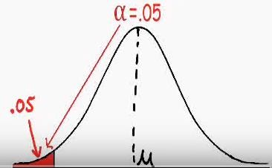
Solution
State hypothesis
H₀ = 100
H_{a} < μ (100)
Significance level α = 0.05
T critical value T = -2.132
Given parameters
μ = 100, s = 15.81, n= 5, sample mean = 89
Find T ?

Slide 35
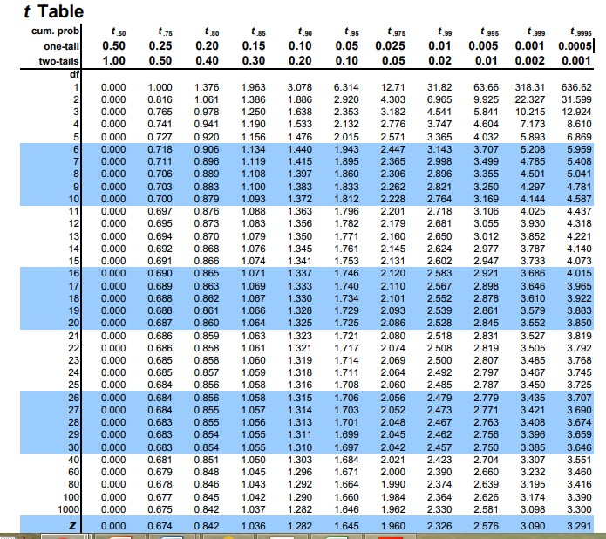
T Table - How to use T table to find critical value ?
Check for the degrees of freedom on Y axis
Check for the Alpha (α ) level in X axis
Degrees of Freedom = n – 1
For < μ use Negative sign

Slide 36
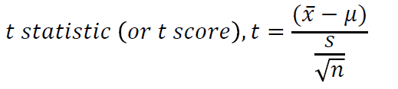
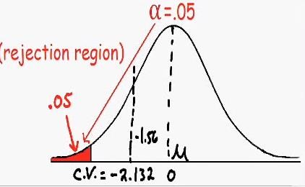
T - Test Statistic
Substituting the parameters
T=-1.56

Slide 37
Conclusion
The calculated T value is not in the critical region
We do not have enough evidence to reject the NULL hypothesis and therefore the average IQ for adults is same as everyone i.e 100

Slide 38

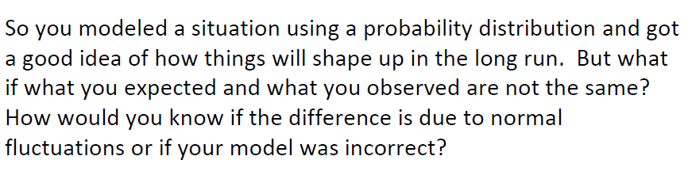

Slide 39
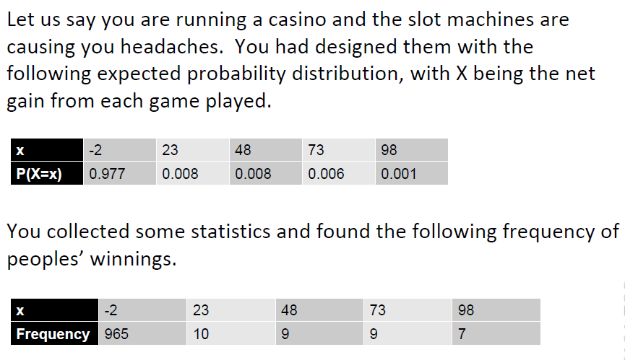

Slide 40
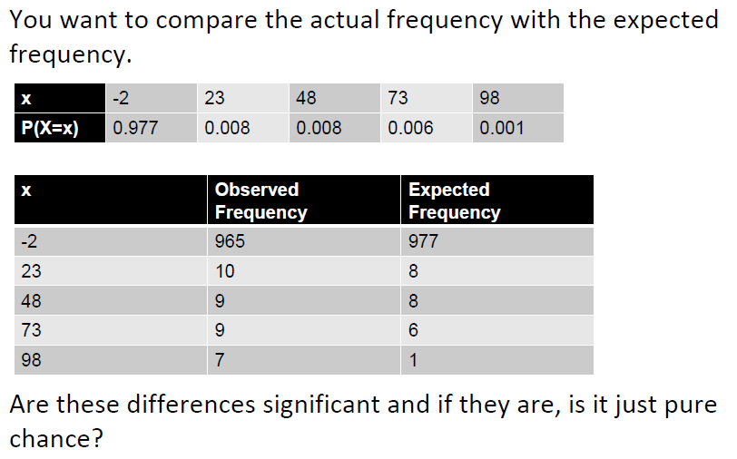

Slide 41
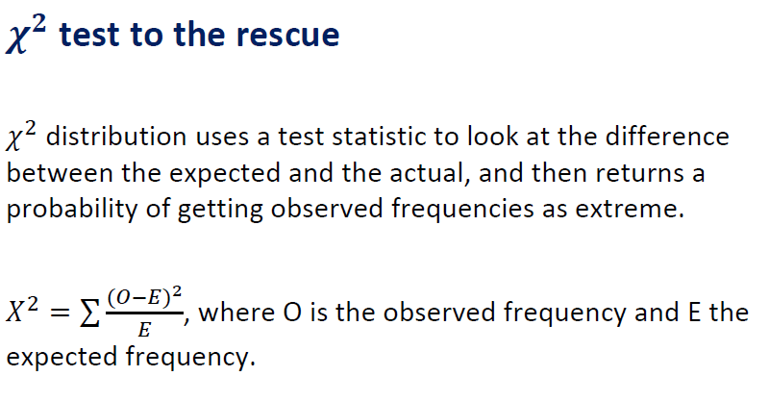

Slide 42
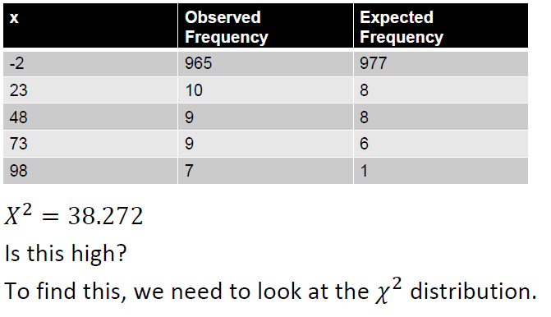

Slide 43
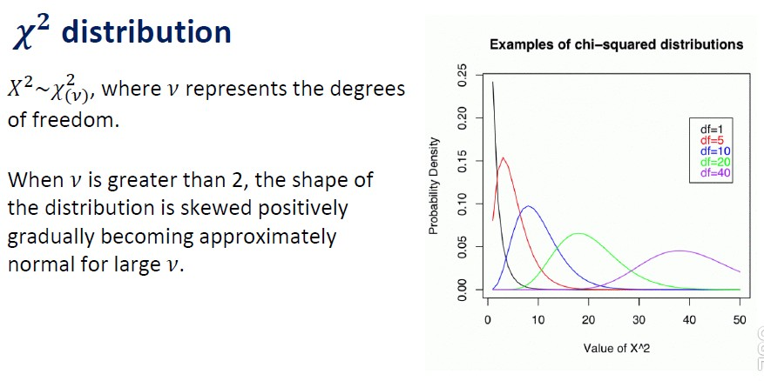

Slide 44
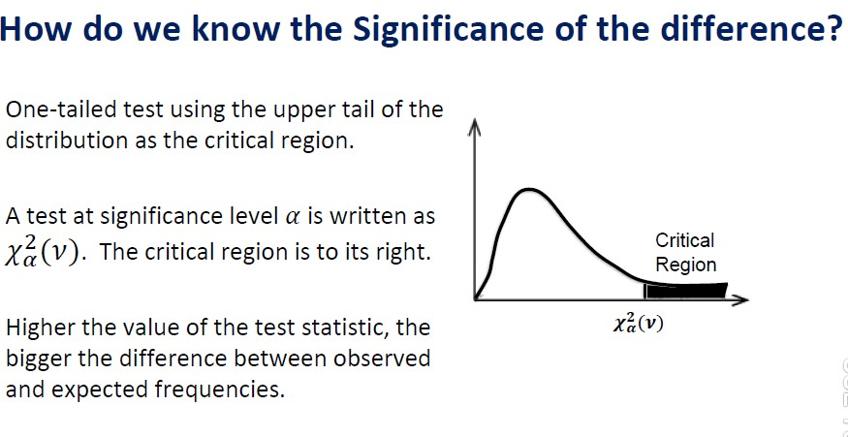

Slide 45
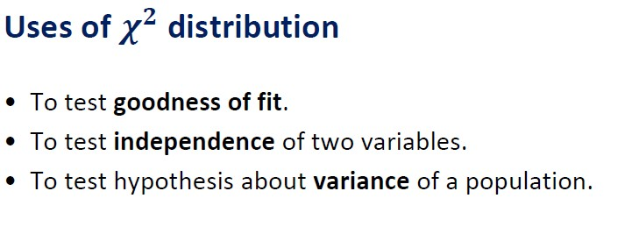

Slide 46
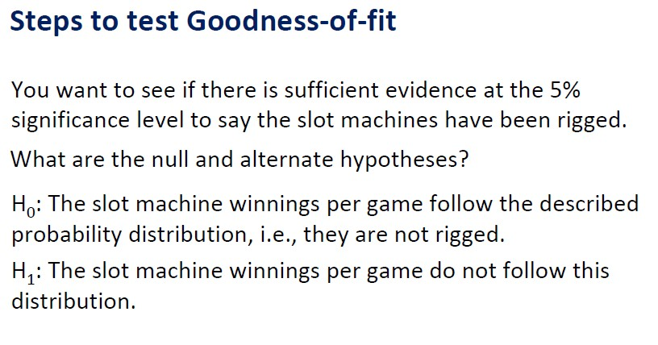

Slide 47
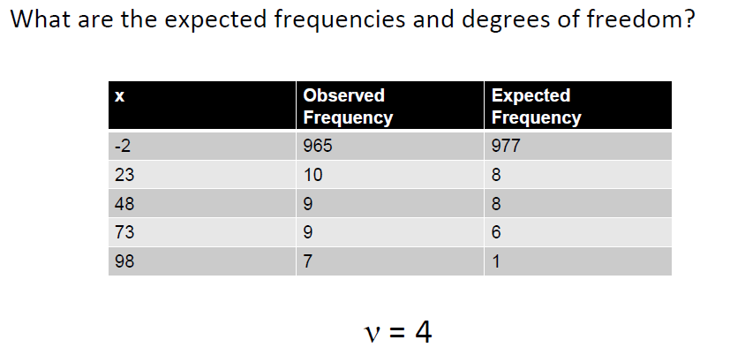

Slide 48
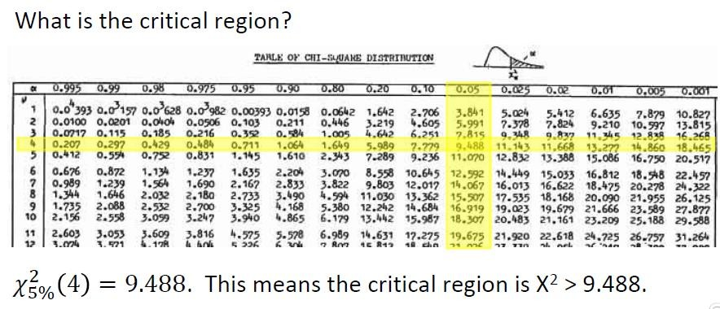

Slide 49
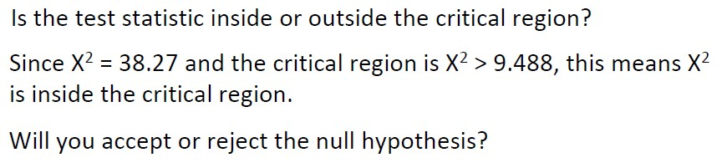
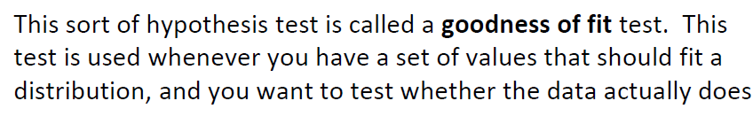

Slide 50
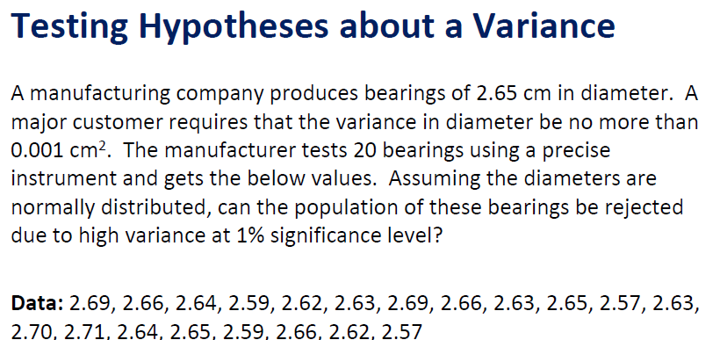

Slide 51
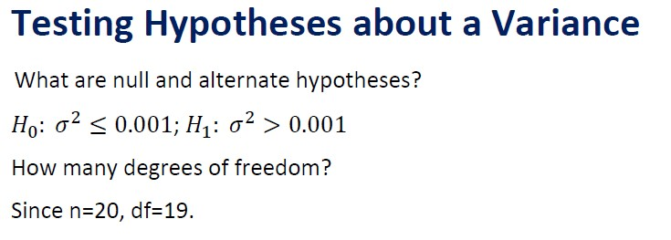

Slide 52
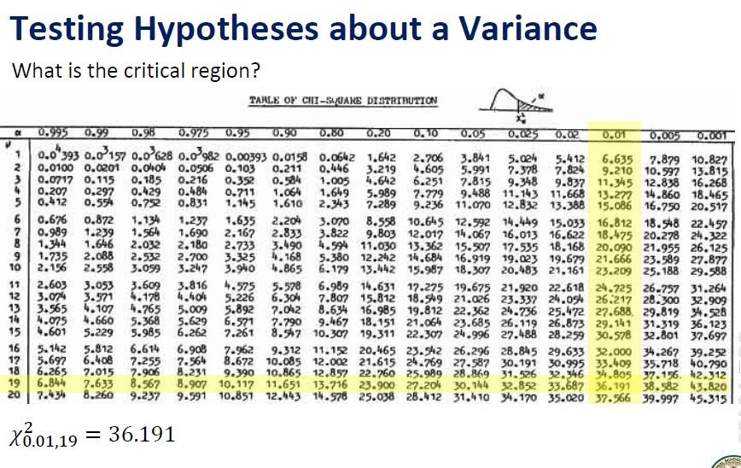

Slide 53
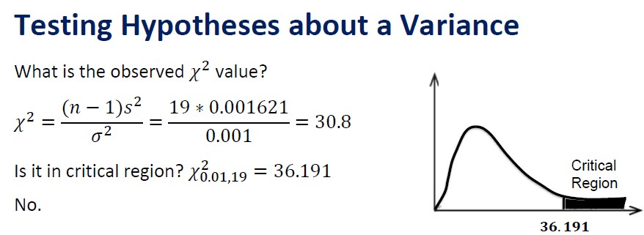


Slide 54

Business decision

Slide 55
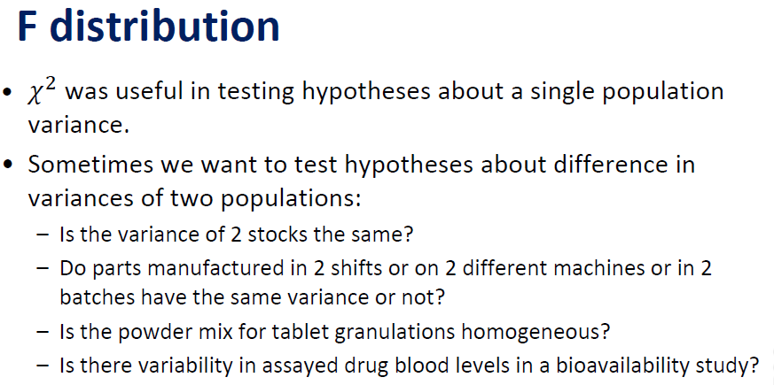

Slide 56
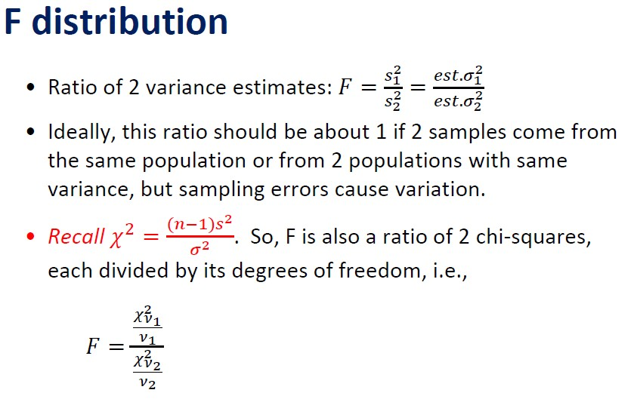

Slide 57
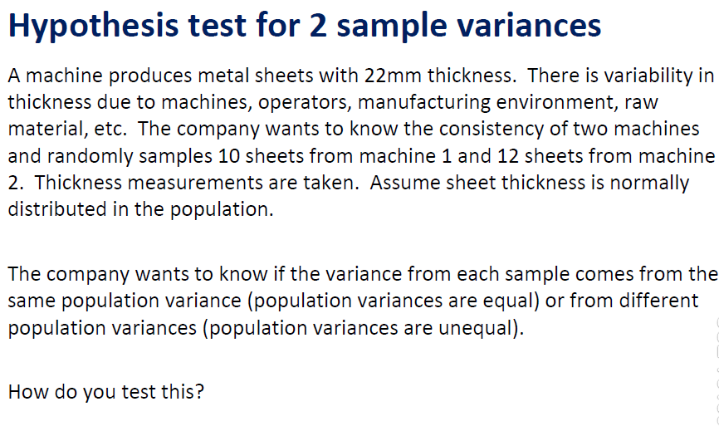

Slide 58
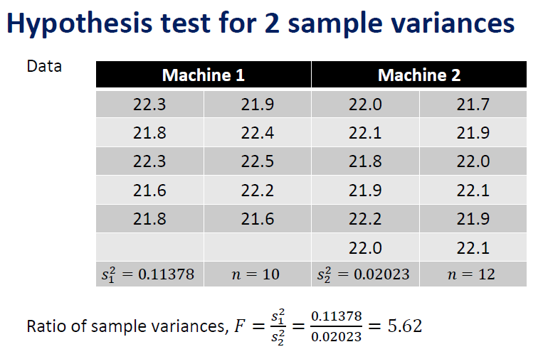

Slide 59
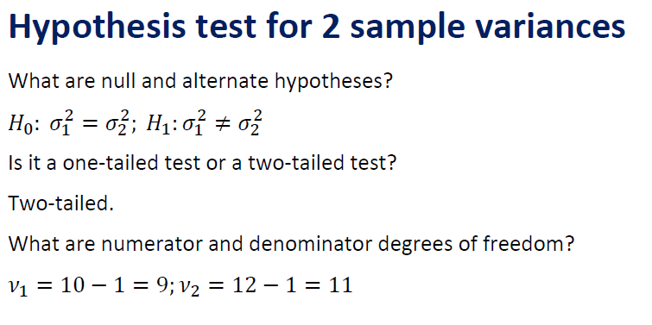

Slide 60
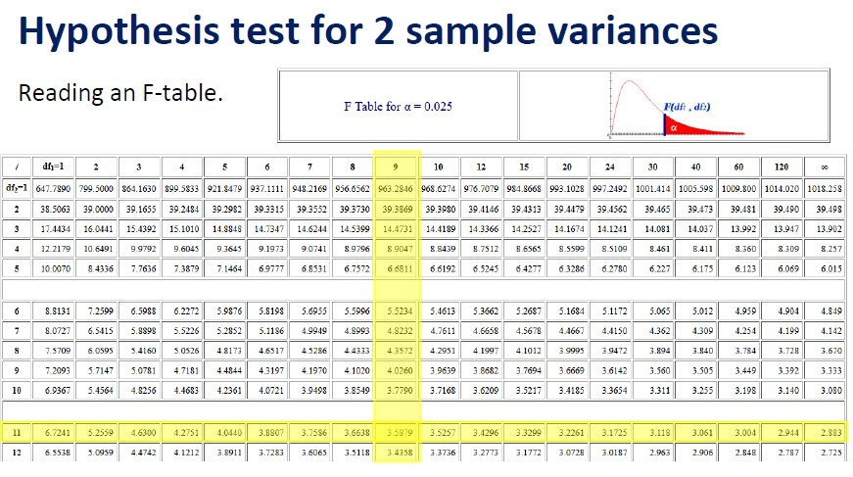


Slide 61


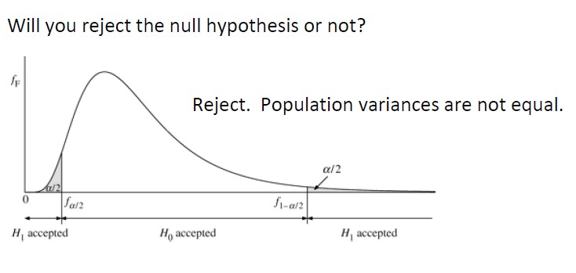

Slide 62

Business decision

Slide 63
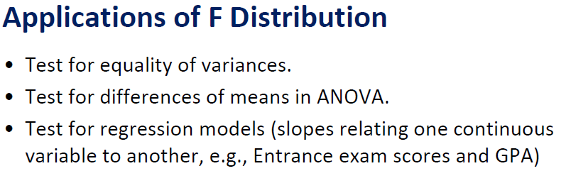

Slide 64
ANOVA

Slide 65
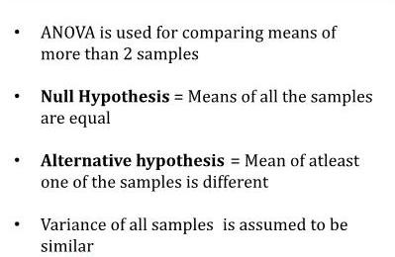
ANOVA(Analysis Of Variance)

Slide 66
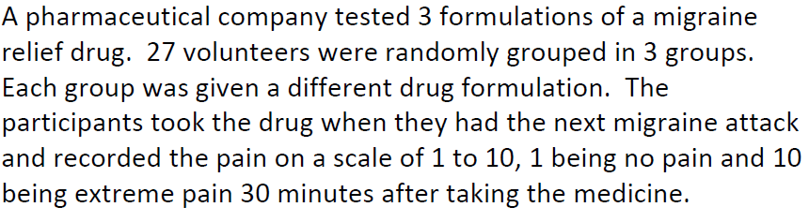

Slide 67


Slide 68


Slide 69


Slide 70


Slide 71



